Slide 1
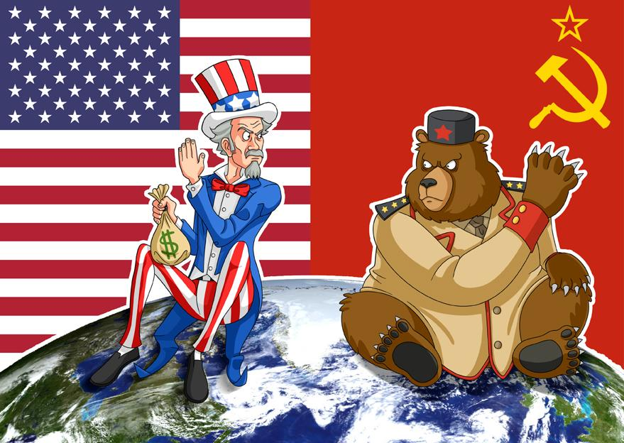
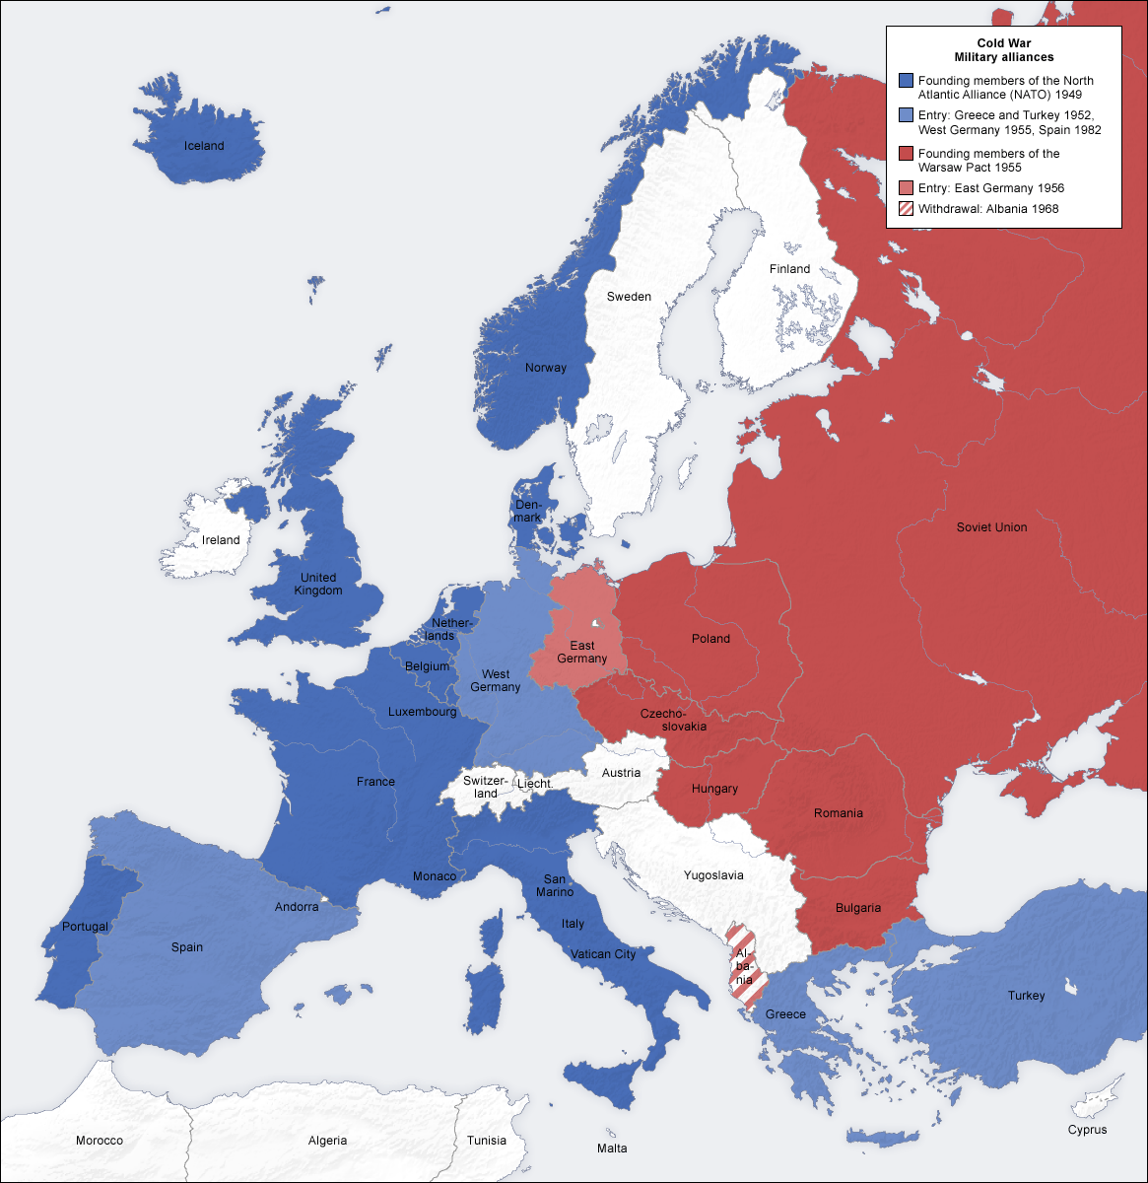
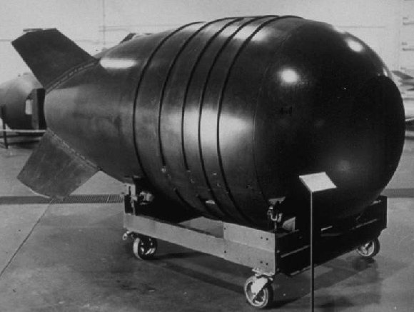
Cold War
the state of political hostility that existed between the Soviet bloc countries and the US-led Western powers from 1945 to 1990
A War of Threats but no direct military action

Slide 2
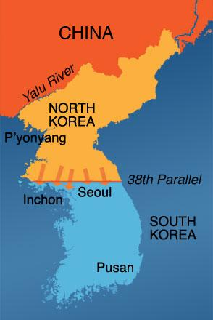
Korean War
A war, also called the Korean conflict, fought in the early 1950s between the United Nations, supported by the United States, and the communist Democratic People's Republic of Korea. (NORTH KOREA)

Slide 3
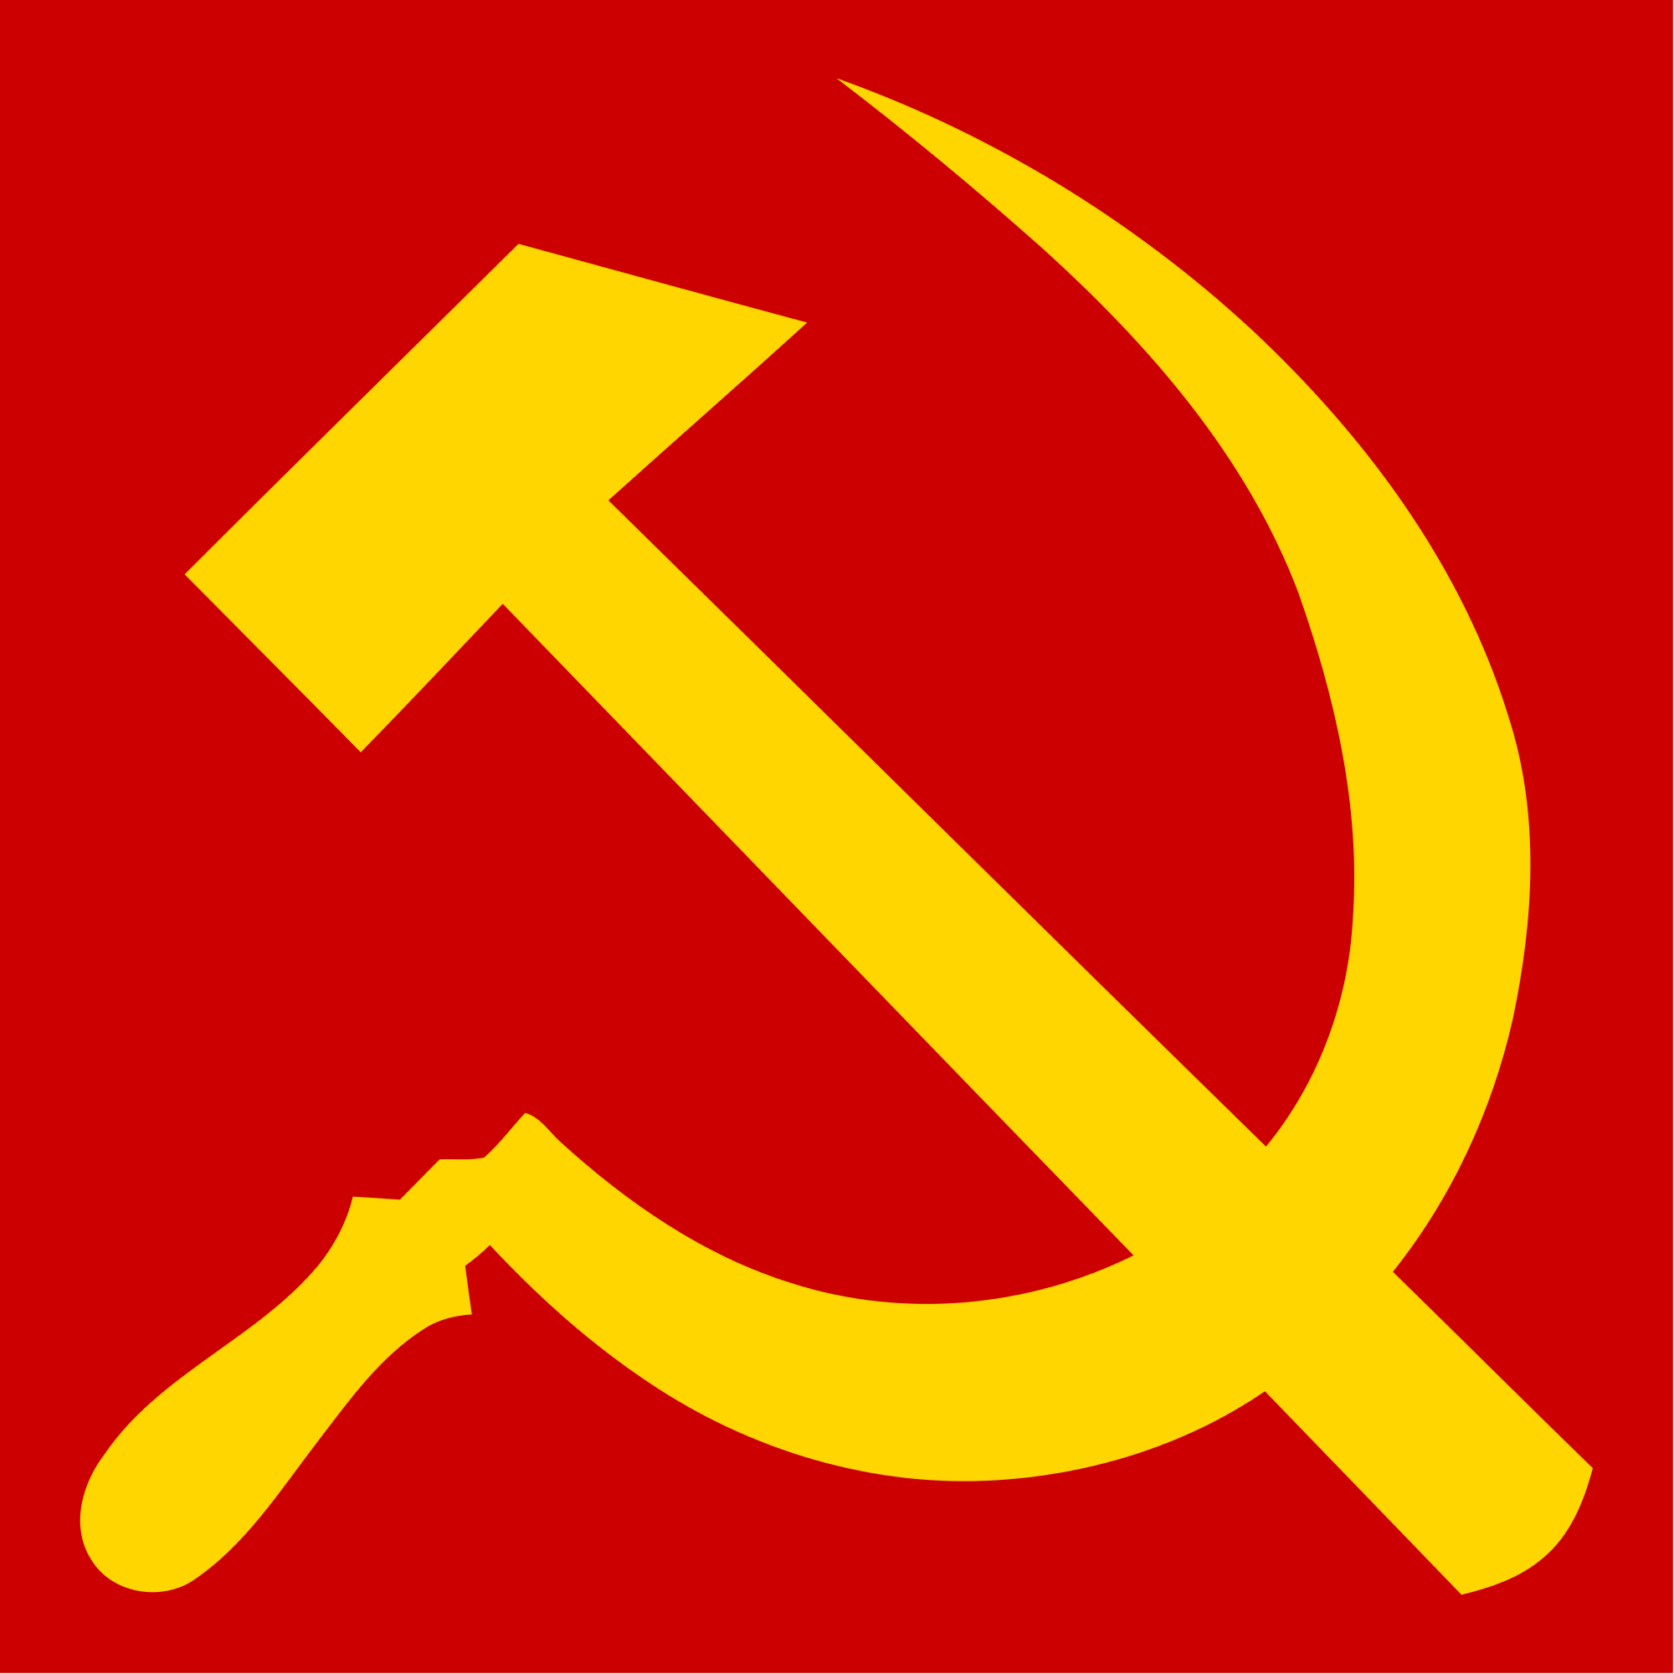
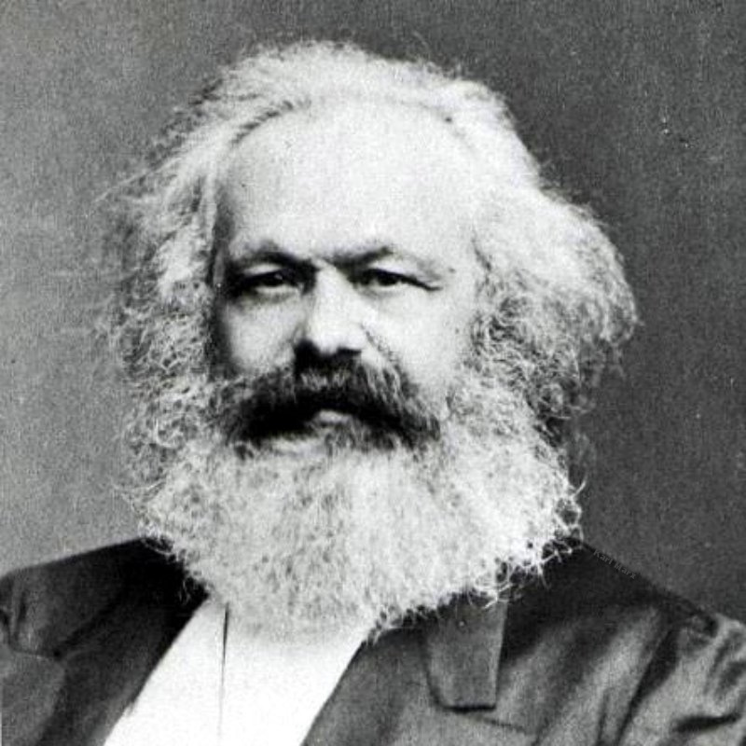
Communism
a political theory derived from Karl Marx, advocating class war and leading to a society in which all property is publicly owned and each person works and is paid according to their abilities and needs. Every Person is paid the same.

Slide 4
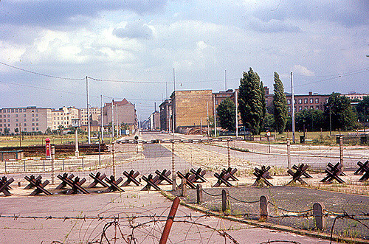
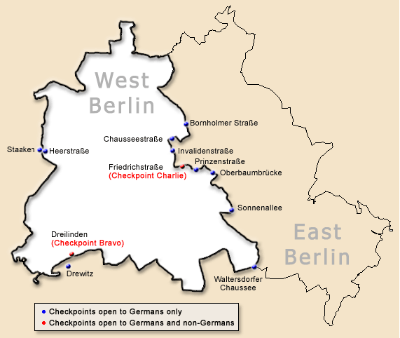
Berlin Wall
Berlin Wall definition. Fortified concrete and wire barrier that separated East and West Berlin from 1961 to 1989. It was built by the government of what was then East Germany to keep East Berliners from defecting to the West.

Slide 5
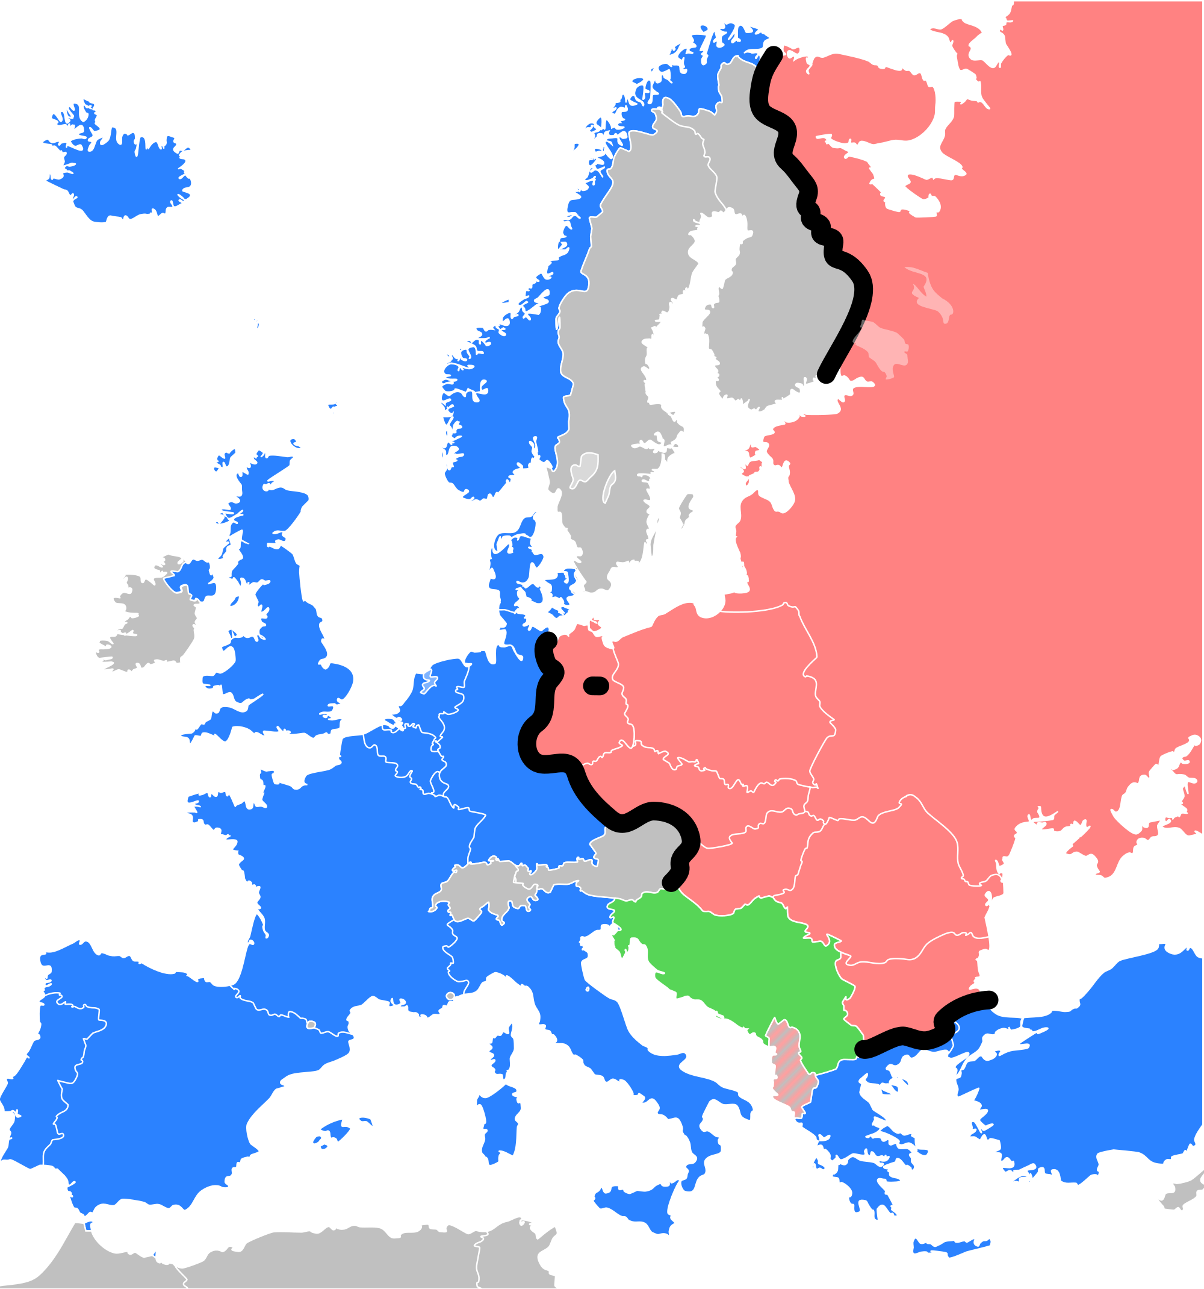
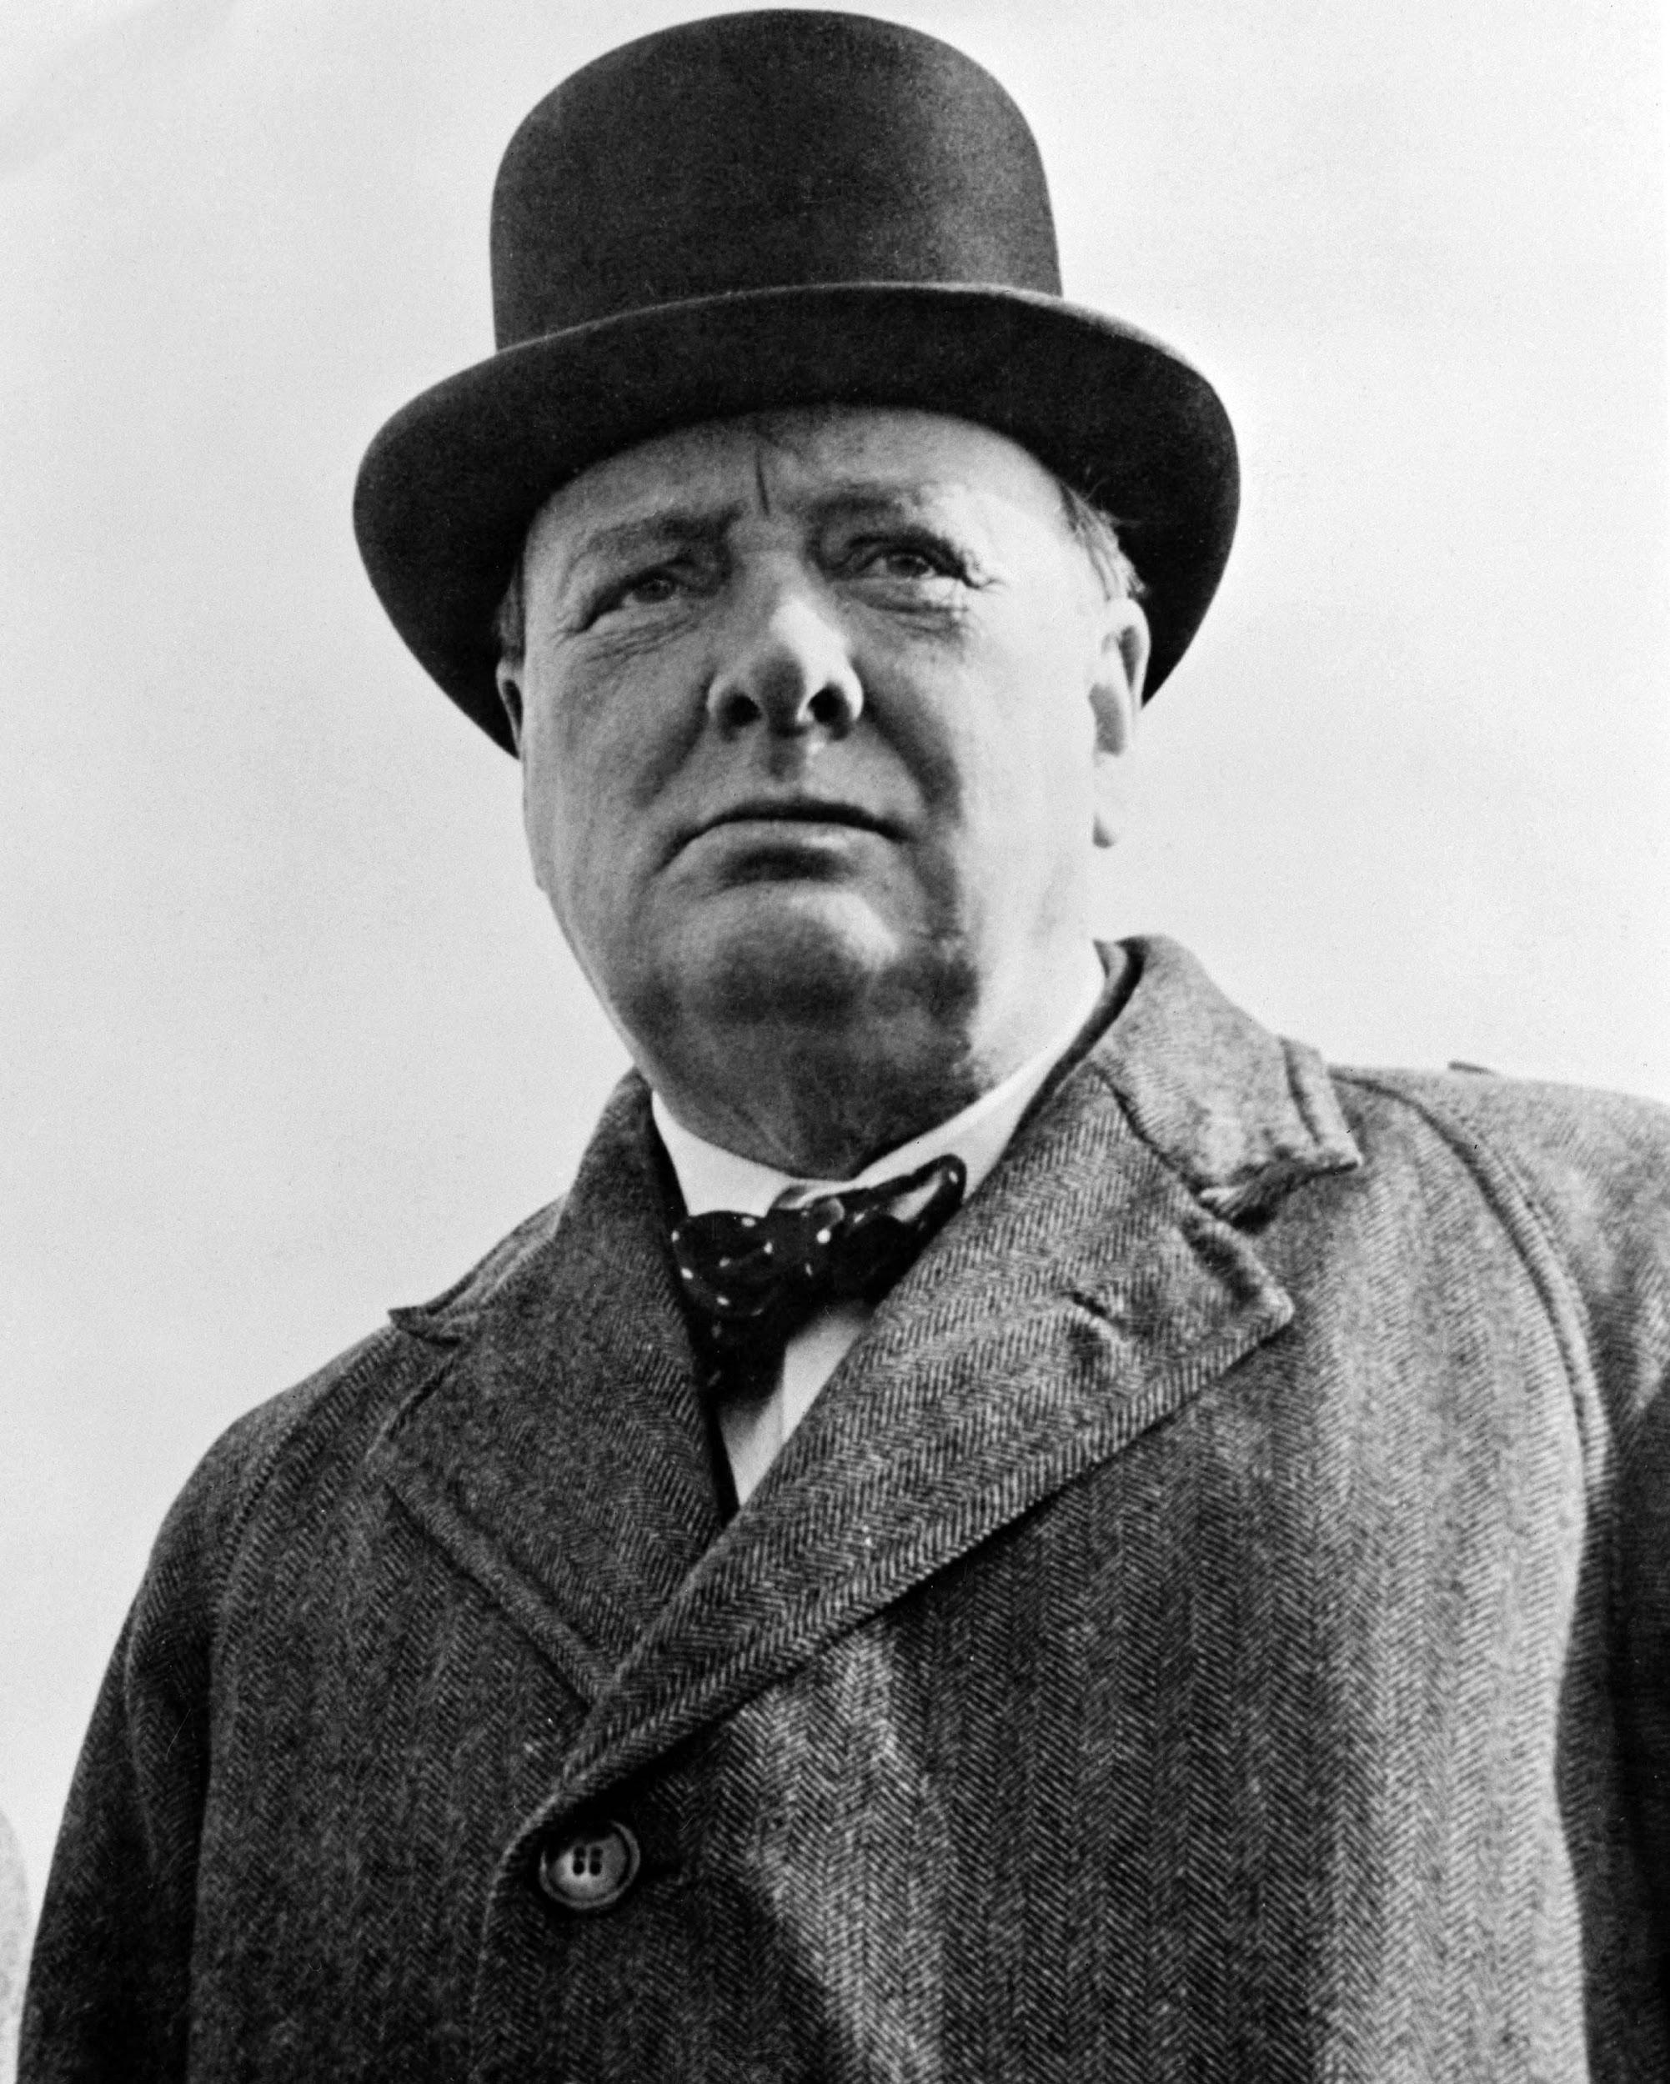
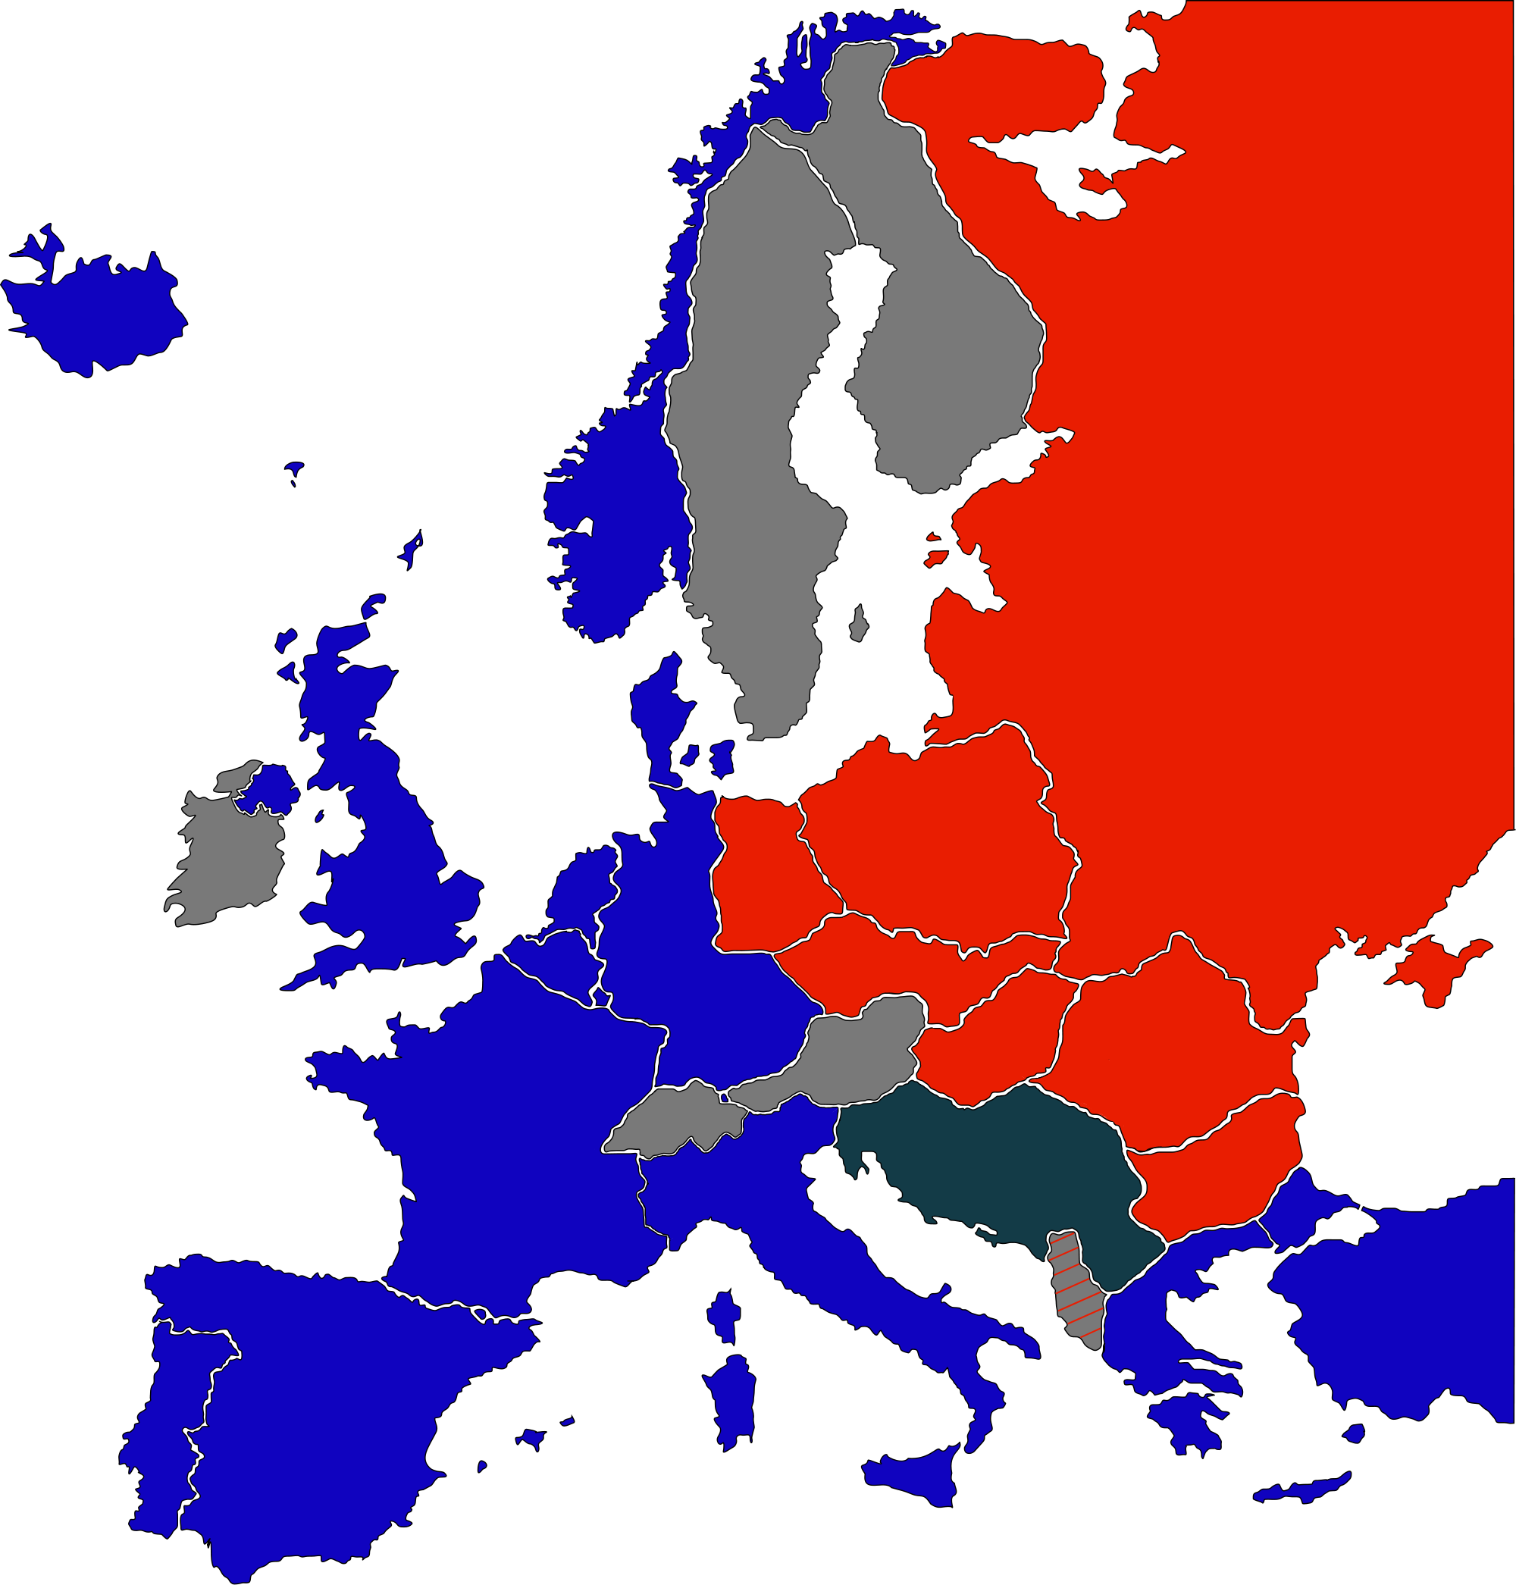
Iron Curtain
The Iron Curtain was the name for the boundary dividing Europe into two separate areas from the end of World War II in 1945 until the end of the Cold War in 1991. A term symbolizing the efforts by the Soviet Union to block itself and its satellite states from open contact with the West and non-Soviet-controlled areas. COMMUNISM vs CAPITALISM ,,,,, NATO VS WARSAW PACT

Slide 6
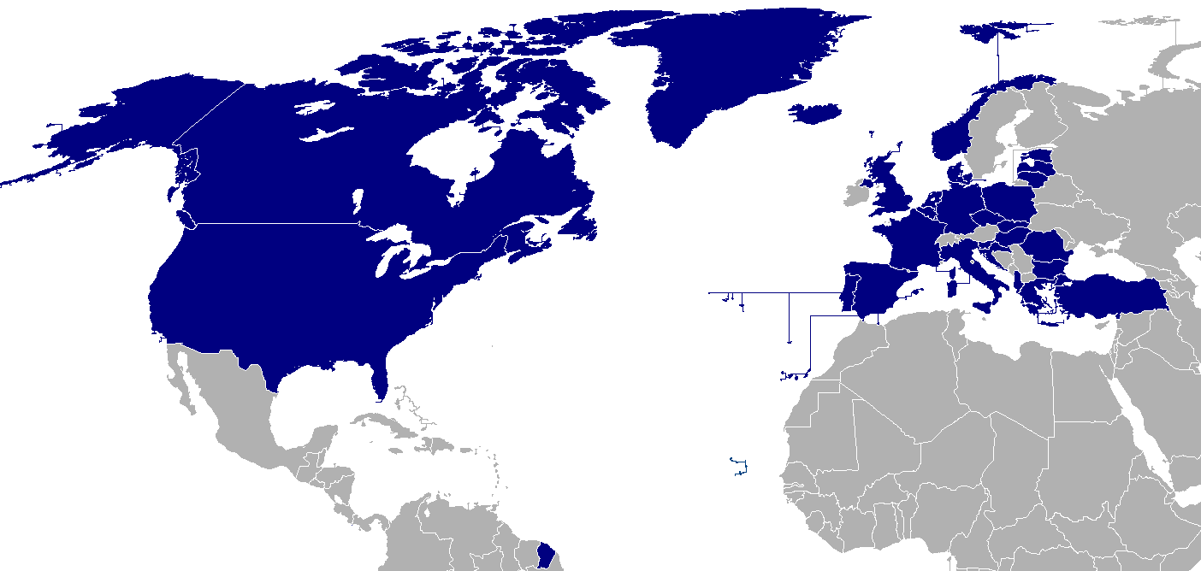
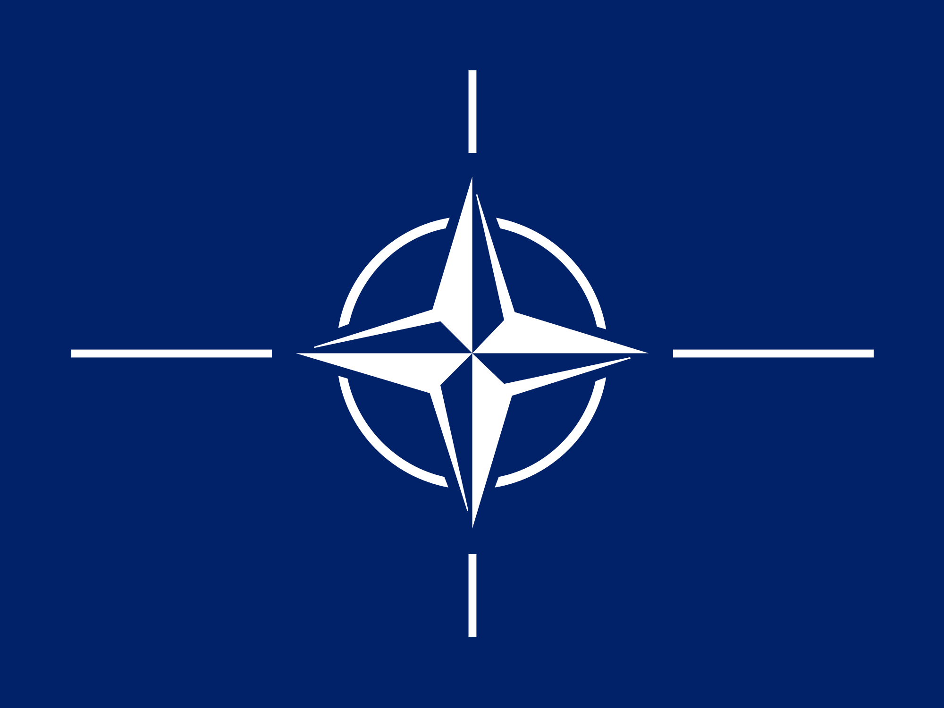
NATO
NATO, the North Atlantic Treaty Organization, is a military alliance of European and North American democracies founded after World War II to strengthen international ties between member states—especially the United States and Europe—and to serve as a counter-balance to the Soviet Union and the Warsaw Pact.

